Slide 1
Sensor Fusion: Ultrasonic Sensor PGA460 and Murata MA58MF14-7N
Summer 2019
Presenter: My Uyen Nguyen, MIT
Mentor: Ankur Deo

Slide 2
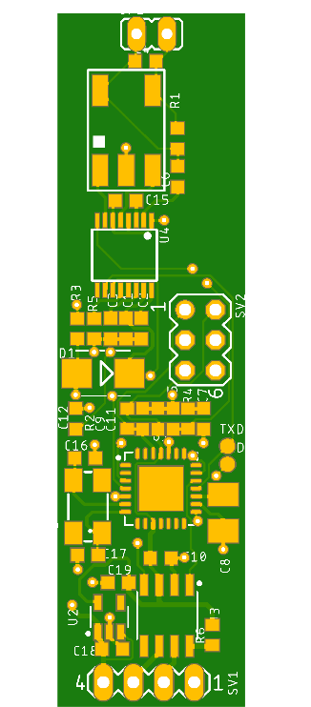
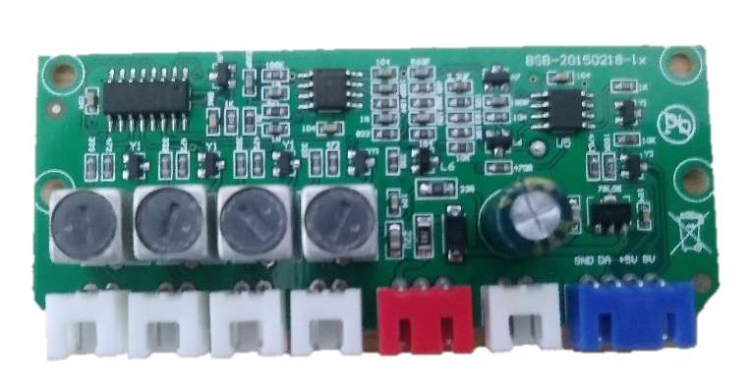
Related Works
On Vehicle
Developed Embedded Platform
Product specs
4 ultrasonic sensors
Up to 2 meters
4 frames per second
1 ultrasonic sensor
Unknown distance range
Unknown feed rate

Slide 3
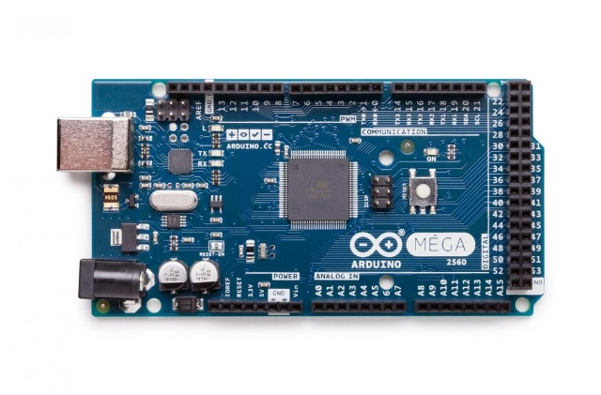
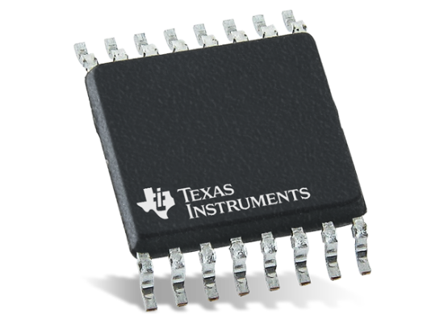
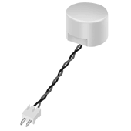
Project Objectives
Accurate and consistent distance measurement of up to 2 meters
Feed rate of >= 10 frames per second
Multiple sensors configuration using 1 microcontroller
Microcontroller
Ultrasonic Driver
Ultrasonic sensor

Slide 4
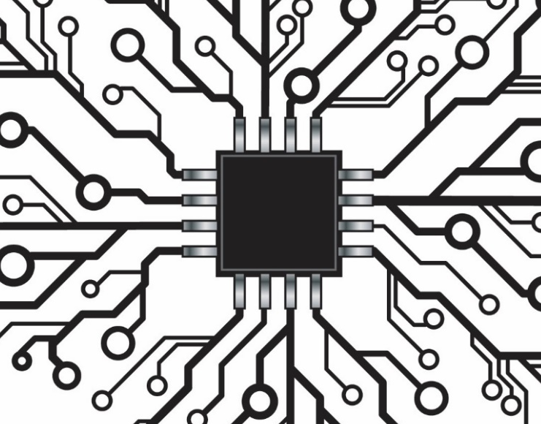
Challenges and Troubleshooting
Unreliable hardware and software
Failed serial communication and burst+listen
Constant distance measurement regardless of object detection
Invalid data transmission
Incomplete understanding of ultrasonic driver’s method of operation
X
X
Microcontroller
Ultrasonic Driver
Ultrasonic sensor

Slide 5

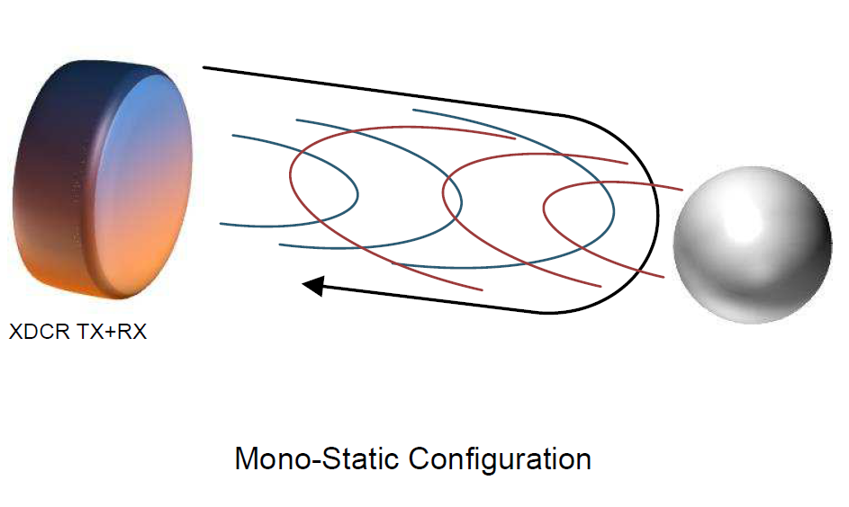


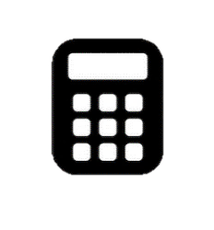
Method of Operation
INITIALIZATION – EEPROM, Threshold, AFEGAIN + TVG
BURST + LISTEN
Loop
PULL + FILTER DATA
COMPUTE DISTANCE

Slide 6
Modified Method of Operation
Additional Methods of Data Communication
USB Communication for PC
CAN Bus for ECUs
BURST + LISTEN
PULL + FILTER DATA
COMPUTE DISTANCE
1
2
3

Slide 7
Results
 | Third-Party Device | Inherited Device
Number of sensors | 4 | 1 | 1 | 2 | 3
Min distance (m) | N/A | N/A | 0.25 | 0.25 | 0.25
Max distance (m) | 2.0 | N/A | 3.5 | 3.5 | 3.5
Frames per second | 4 | N/A | 45-50 | 44 | 43
Accuracy | N/A | N/A | +/- .02 | +/- .02 | +/- .02
Performance Comparison
Developed Embedded System

Slide 8
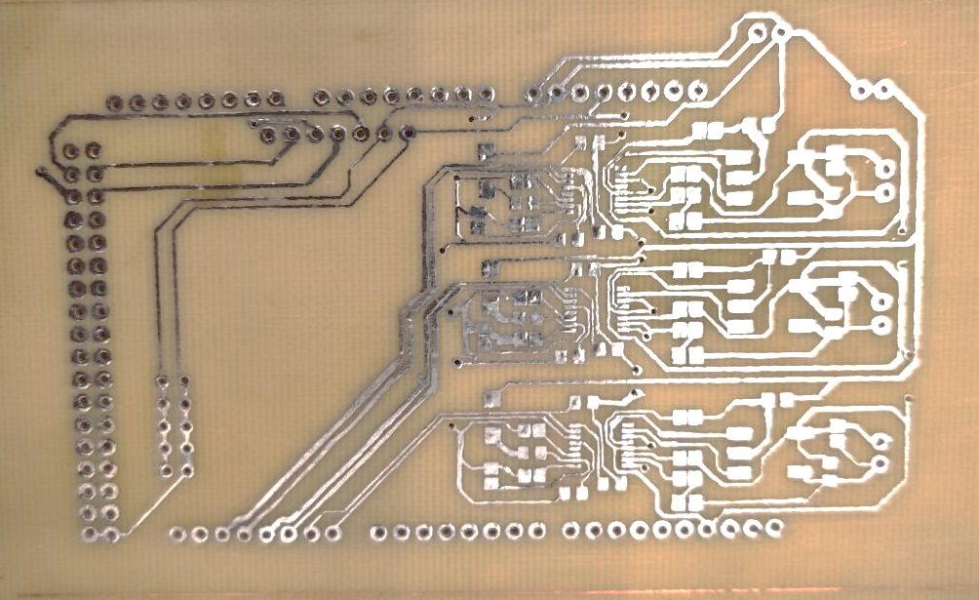
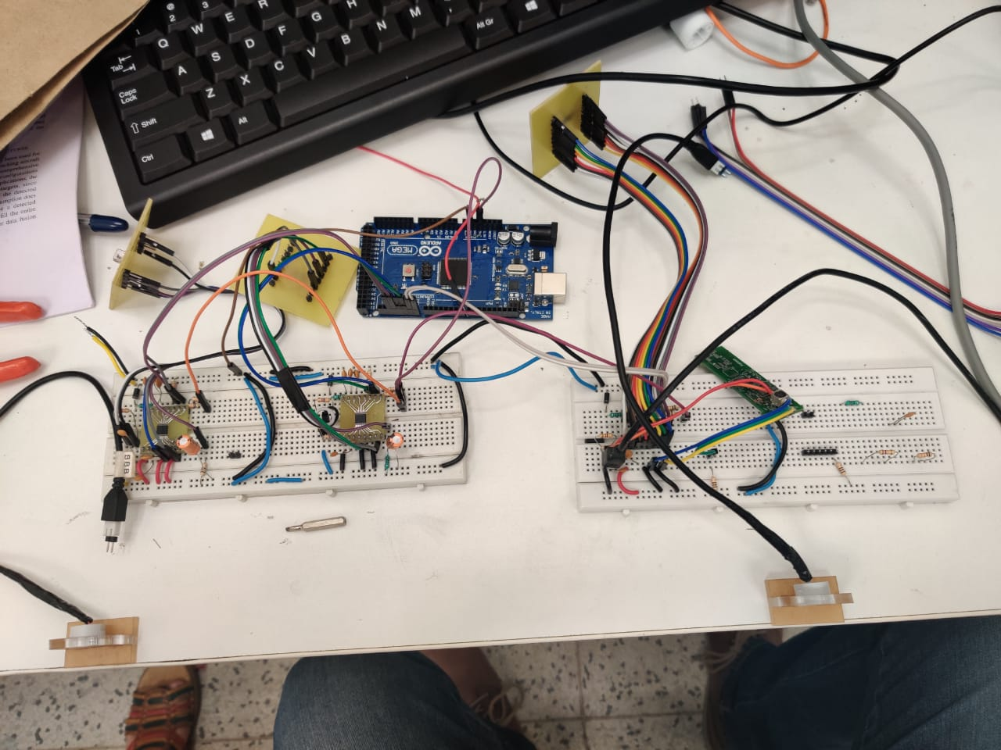
Product Reveal

Slide 9
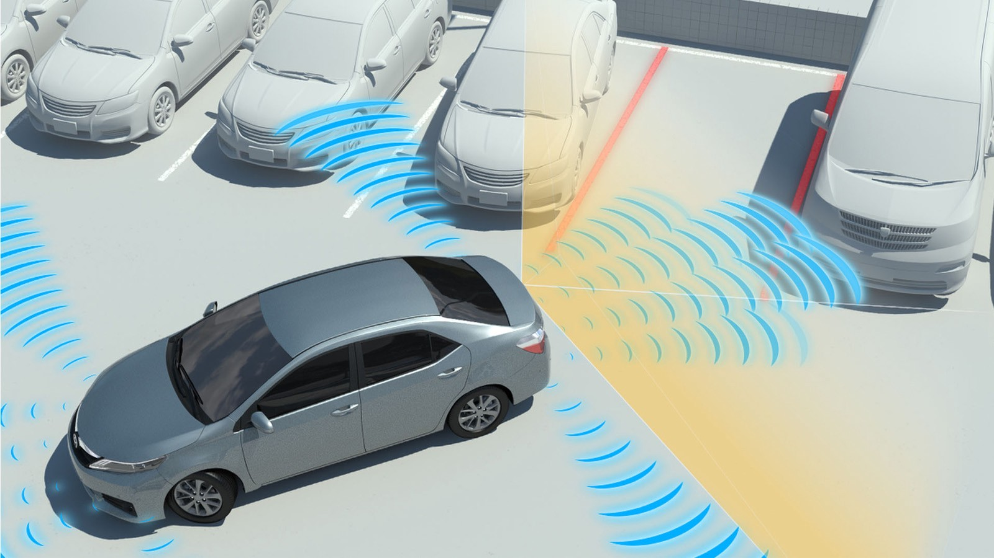
Future Works
Future Works
Manufacture PCB for multiple-sensors setup (IN PROGRESS)
Test PCB outside of lab and confirm maximum distance range
Install sensors onto vehicle for real-time testing
Increase number of ultrasonic sensors driven by one microcontroller using SoftwareSerial

Slide 10
Thank you for a wonderful time at KPIT and in India
Special thanks to Ankur Deo and Sant Ranjan

